Slide 1
#CA8 PROTECTION AND INFORMATION FLOW OF PASSENGER BAGGAGE AT AIRPORTS,DOMESTIC AIRPORTS
AIRPORT AUTHORITY OF INDIA,MINISTRY OF CIVIL AVIATION
SUBMITTED BY,
ARUN KOUSHIK
FAHEEN FATHIMA B N
KARTHICK U
MADHUMITHA P R
PRAVEEN T
VIGNESH RAM

Slide 2
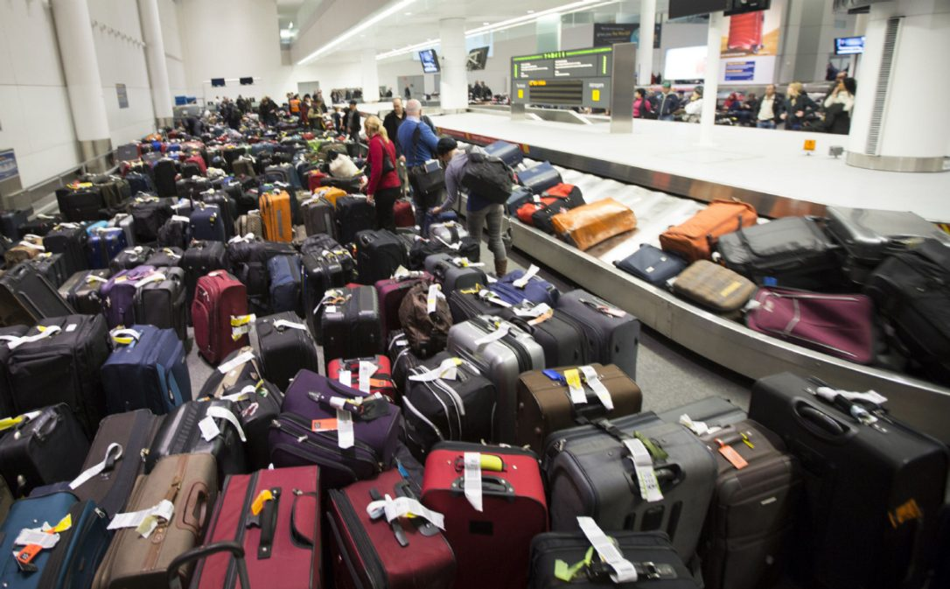
Problem statemennt
Loss of time
Inavailablity of baggage information
Assumption of baggage location

Slide 3
ELECTRONOMAGNETISM
Magnetisation and demagnetisation
Frequency emitting devices
RFID
radio frequency identification
Frequency signals upto 433mhz

Slide 4
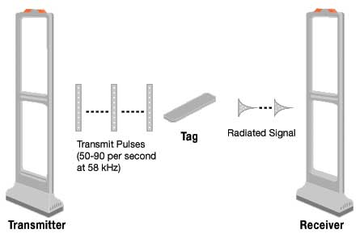
THREE MAIN CONCEPTS
EAS
READING
SIGNALLING
WRITING

Slide 5
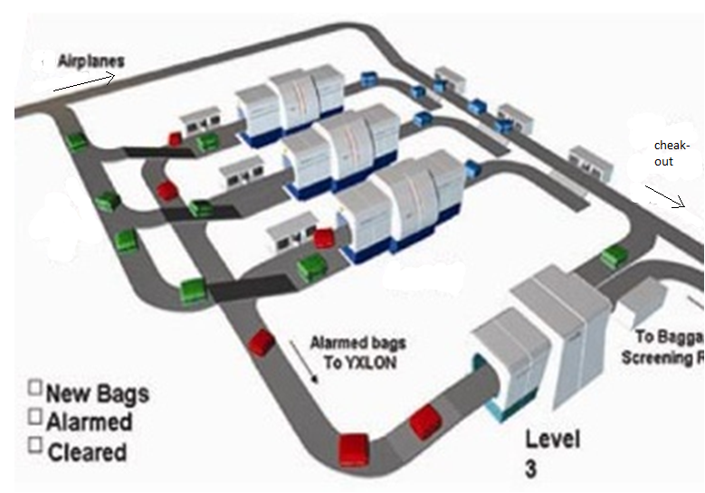
OVERVIEW OF BAGGAGE TRAVEL IN AIRPORT

Slide 6
STEPS INVOLVED IN TRACKING THE BAGGAGE
TAGGING (MAGNETIZATION)
SCANNINNG
RETRIVAL (DEMAGNETIZATION)

Slide 7
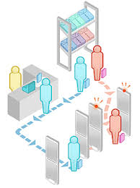
SOLUTIONS
POSITION OF BAGGAGE
SURVEILENCE OF BAGGAGE
TIME CALCULATION
COVEYER BELT FIXED SPEED
COMPARTMENTS

Slide 8
SUM UP:
SCANNING OF TAGS
GETTING INFORMATION(CONTACT NUMBER)
PROCESSING USING SENSORS
DATABASE +JAVA INFORMATION FOR SMS
ALERT THE PASSENGERS
REMOVAL OF TAG

Slide 9
THANK YOU!

